Slide 1


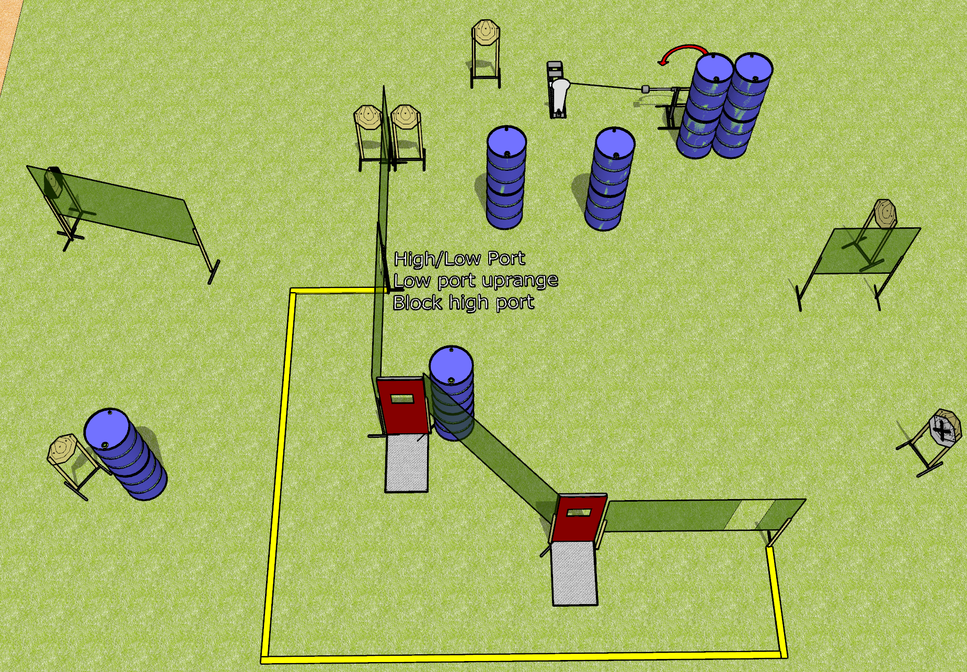
 | Dothan Gun Club – USPSA Match Just Why Course Designer : Drew Coleman
Round Count 17 rounds 8 IPSC 1 colt popper
Equipment List 11 wall feet 2 pull down ports Swinger + activator 1 tux, 8 targets (7 + 1 NS)

Slide 2
Just Why
Written Stage Briefing
Just Why is a 17 round, 85-point, Comstock course of fire. There are 8 IPSC targets and 1 steel. The best 2 hits on carboard will score.
The swinger is activated by the popper and remains visible at rest.
Handgun start position is anywhere completely outside the shooting area, wrists below belt. Handgun is loaded and holstered.
PCC start position is anywhere completely outside the shooting area, stock on belt. Loaded carbine is held with both hands, safety on belt.
On the audible start signal, engage targets as they become available from within the shooting area.

Slide 3
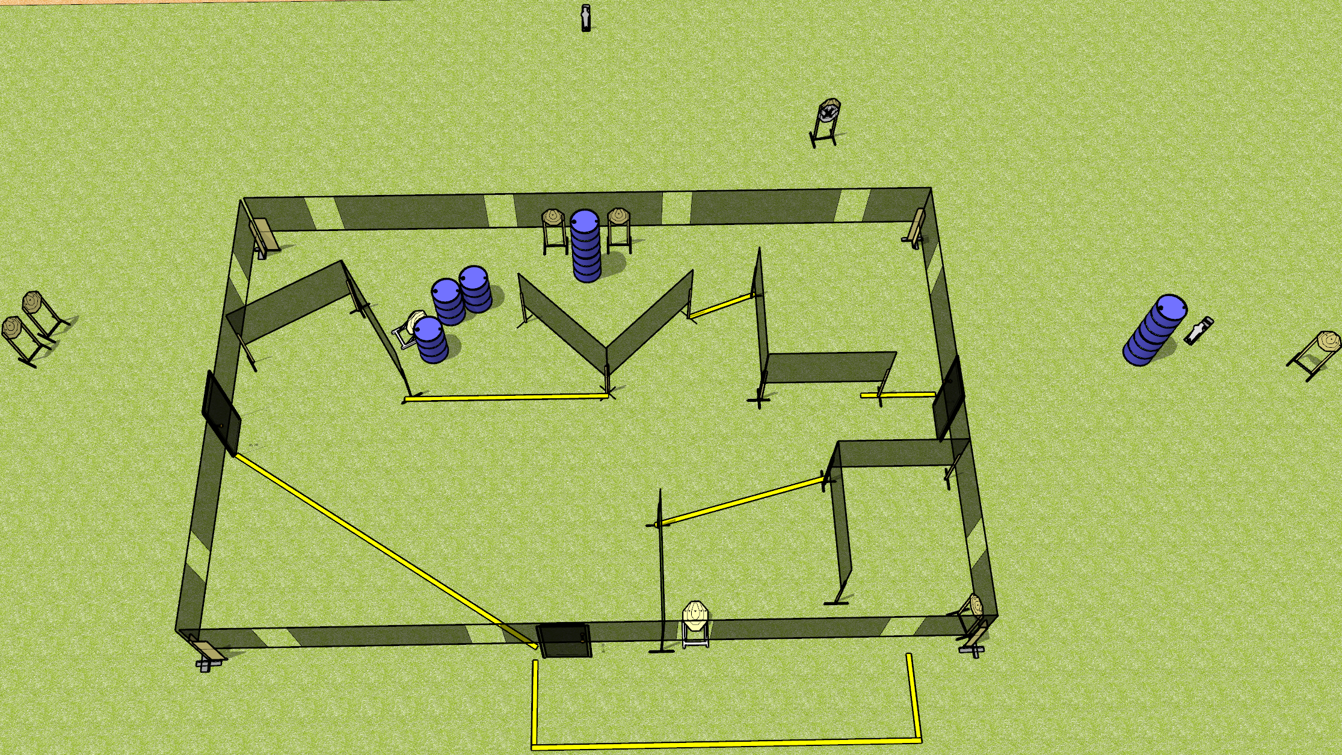
 | Dothan Gun Club – USPSA Match Leg Work Course Designer : Drew Coleman
Round Count 20 rounds 9 IPSC 2 mini poppers
Equipment List 2 wall feet 10 targets (9 + 1 NS)

Slide 4
Leg Work
Written Stage Briefing
Leg Work is a 20 round, 100-point, Comstock course of fire. There are 9 IPSC targets and 2 steel. The best 2 hits on cardboard will score and steel must fall to score.
Handgun start position is both hands touching marks on wall. Handgun is loaded and holstered.
PCC start position is muzzle touching lower mark on wall. loaded carbine is held with both hands.
On the audible start signal, engage targets as they become available from within the shooting area.
All doors must be closed prior to the start signal.

Slide 5
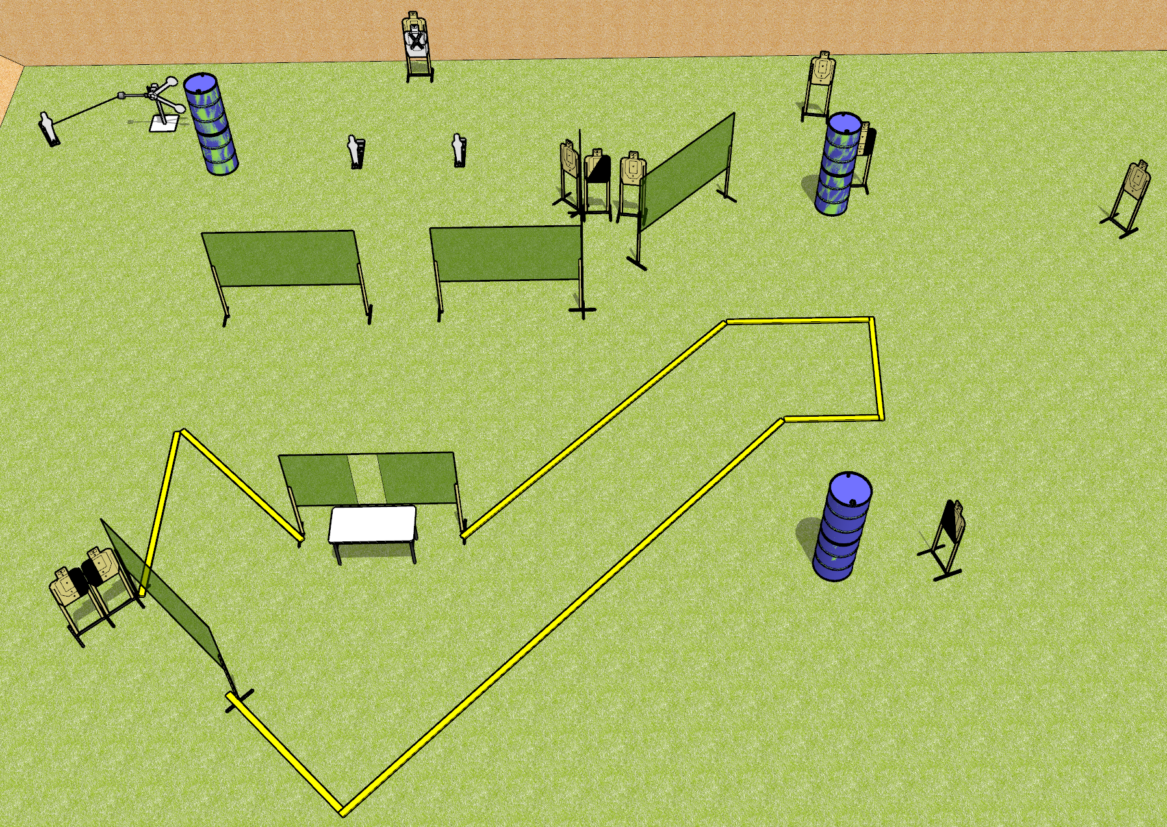
 | Dothan Gun Club – USPSA Match For Your Eyes Only Course Designer : Drew Coleman
Round Count 25 rounds 10 USPSA 3 poppers, 2 plates
Equipment List 11 wall feet 1 left + 1 right, 1 left + 1 right diag, 1 tux, 6 targets (5 + 1 NS) Red stitch swinger + activator 3 18x24 plates and stands

Slide 6
For Your Eyes Only
Written Stage Briefing
For Your Eyes Only is a 25 round, 125-point, Comstock course of fire. There are 10 USPSA targets and 5 steel. The best 2 hits on cardboard will score and steel must fall to score.
The swinger is activated by a popper and remains visible at rest.
Handgun start position is hands on marks. Pistol is inside briefcase, unloaded, pointed down range. First magazine to be used on top of briefcase, touching paster.
PCC start position is hands on marks. First magazine to be used is inside briefcase. Carbine is on top of briefcase, trigger guard on paster, unloaded, pointed down range.
On the audible start signal, engage targets as they become available from within the shooting area.
Briefcase will be closed and unlatched prior to start signal. Paster will be centered on lid of briefcase. Briefcase must be touching marks on table. Shooter may arrange briefcase to open left OR right before course of fire.

Slide 7
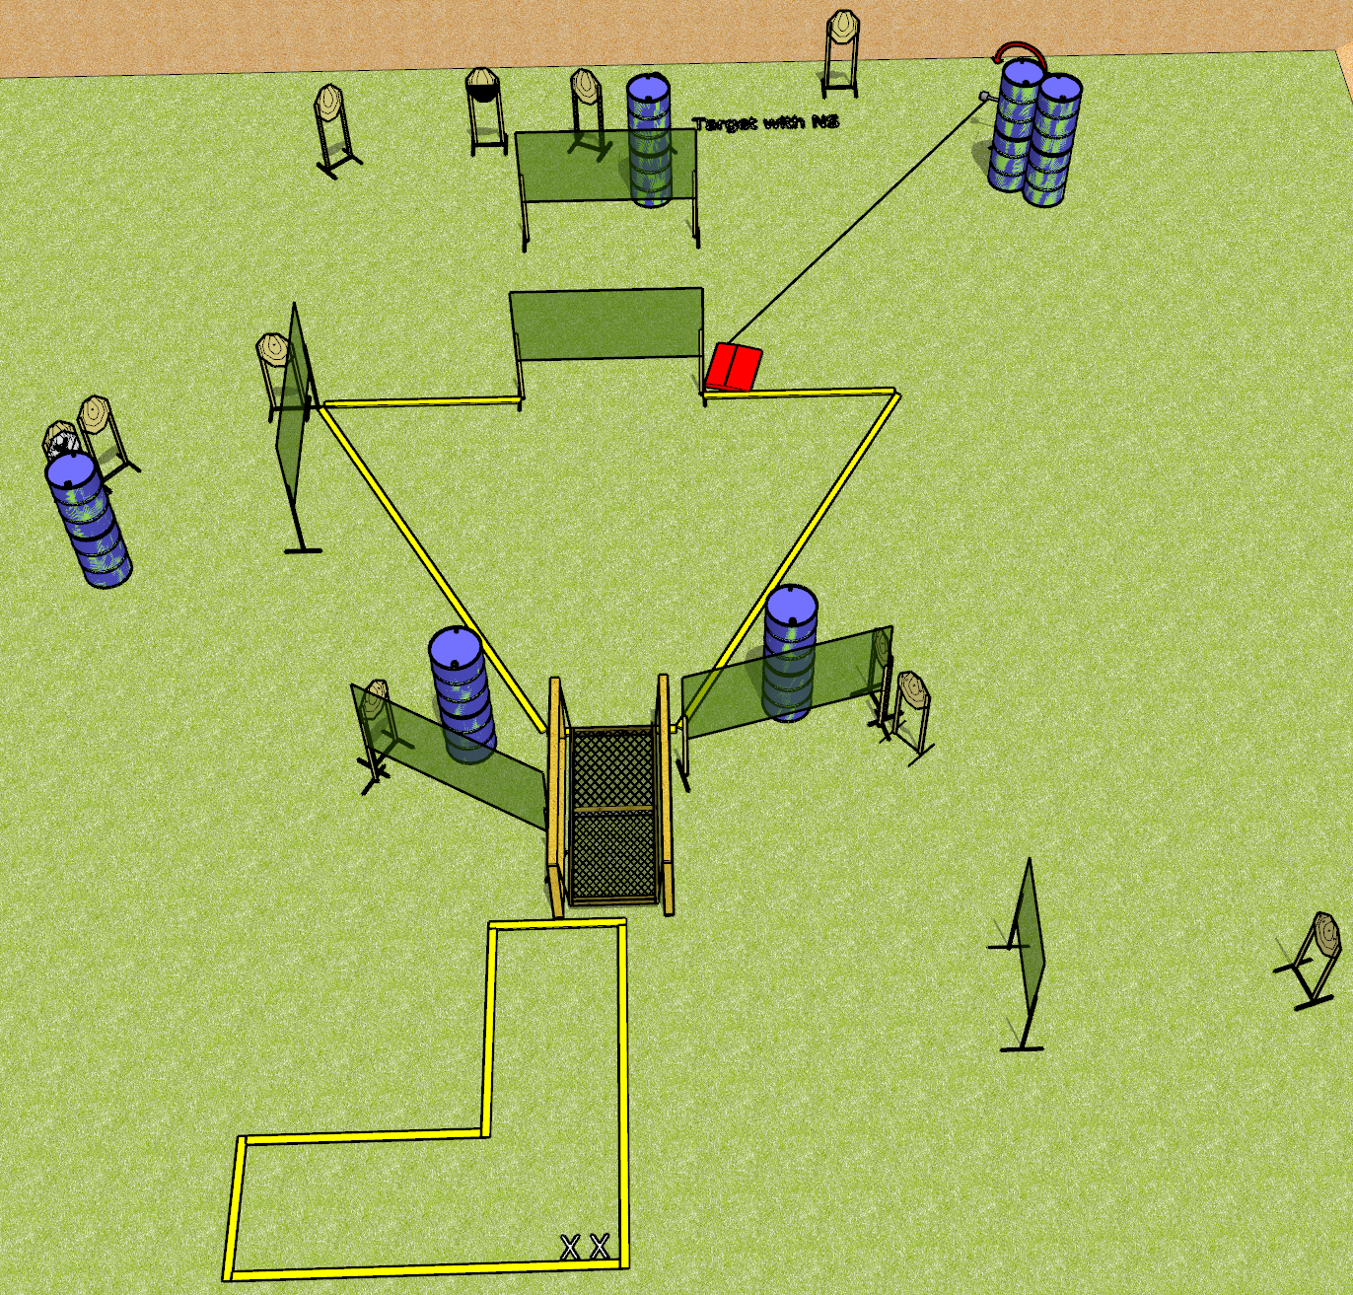
 | Dothan Gun Club – USPSA Match Suck it up Buttercup Course Designer : Drew Coleman
Round Count 26 rounds 13 IPSC
Equipment List 12 wall feet Bridge Swinger + stomp pad 1 50%, 14 paper (12 + 2 NS)

Slide 8
Suck it up Buttercup
Written Stage Briefing
Suck it up Buttercup is a 26 round, 130-point, Comstock course of fire. There are 13 IPSC targets. The best 2 hits will score.
Handgun start position is heels on X’s, wrists below belt. Handgun is loaded and holstered.
PCC start position is heels on X’s, stock on belt. Loaded carbine is held with both hands, safety on.
On the audible start signal, engage targets as they become available from within the shooting area.
The bridge supports, railing, chains, and frame are NOT part of the shooting area. The platform is part of the shooting area.

Slide 9
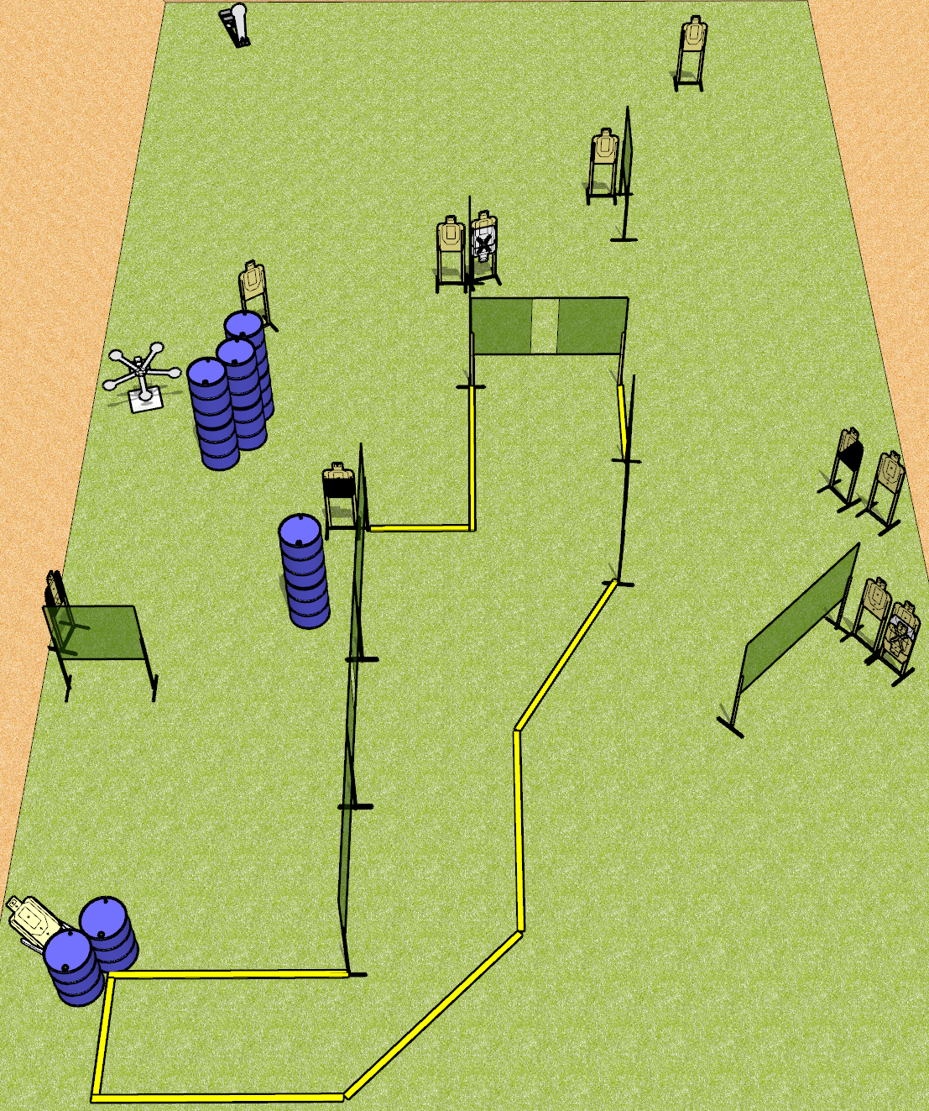
 | Dothan Gun Club – USPSA Match Tricky Dicky Course Designer : Drew Coleman
Round Count 32 rounds 13 USPSA 5 plates, 1 colt popper
Equipment List 15 wall feet Star 1 tux, 1 50%, 1 diag, 12 targets (10 + 2 NS)

Slide 10
Tricky Dicky
Written Stage Briefing
Tricky Dicky is a 32 round, 160-point, Comstock course of fire. There are 13 USPSA targets and 6 steel. The best 2 hits on cardboard will score, and steel must fall to score. The start signal is audible.
Handgun start position is anywhere inside the shooting area, wrists below belt. Handgun is loaded and holstered.
PCC start position is anywhere inside the shooting area, stock on belt. Loaded carbine is held with both hands, safety on.
On the audible start signal, engage targets as they become available from within the shooting area.

